Slide 1

The Last Capture
Second delivery – Creative Technologies, Semester 5.
Team: Yibai Zhang & Vasco Pauthier

Slide 2
Game
VR puzzle and escape game with brand activation.

Slide 3

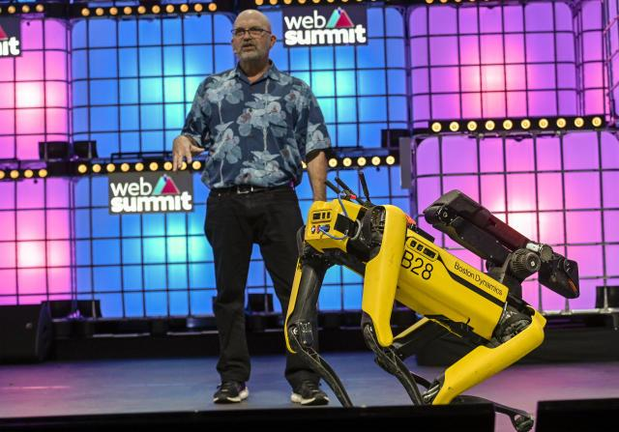
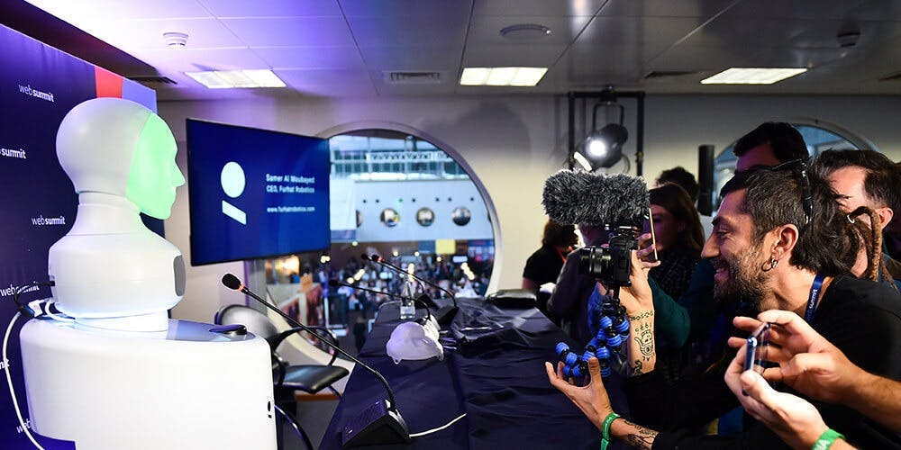
Client – Web Summit
Web Summit is an annual technology conference held in Lisbon, Portugal, considered the largest tech event in the world.

Slide 4
Game concept
A reporter is late for the Web Summit convention and he needs to get to there as fast as possible.
Unfortunately for him the path to the exit is filled with puzzles and obstacles he needs to overcome.

Slide 5
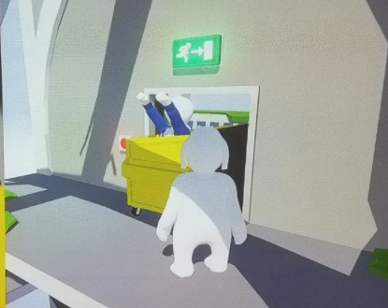
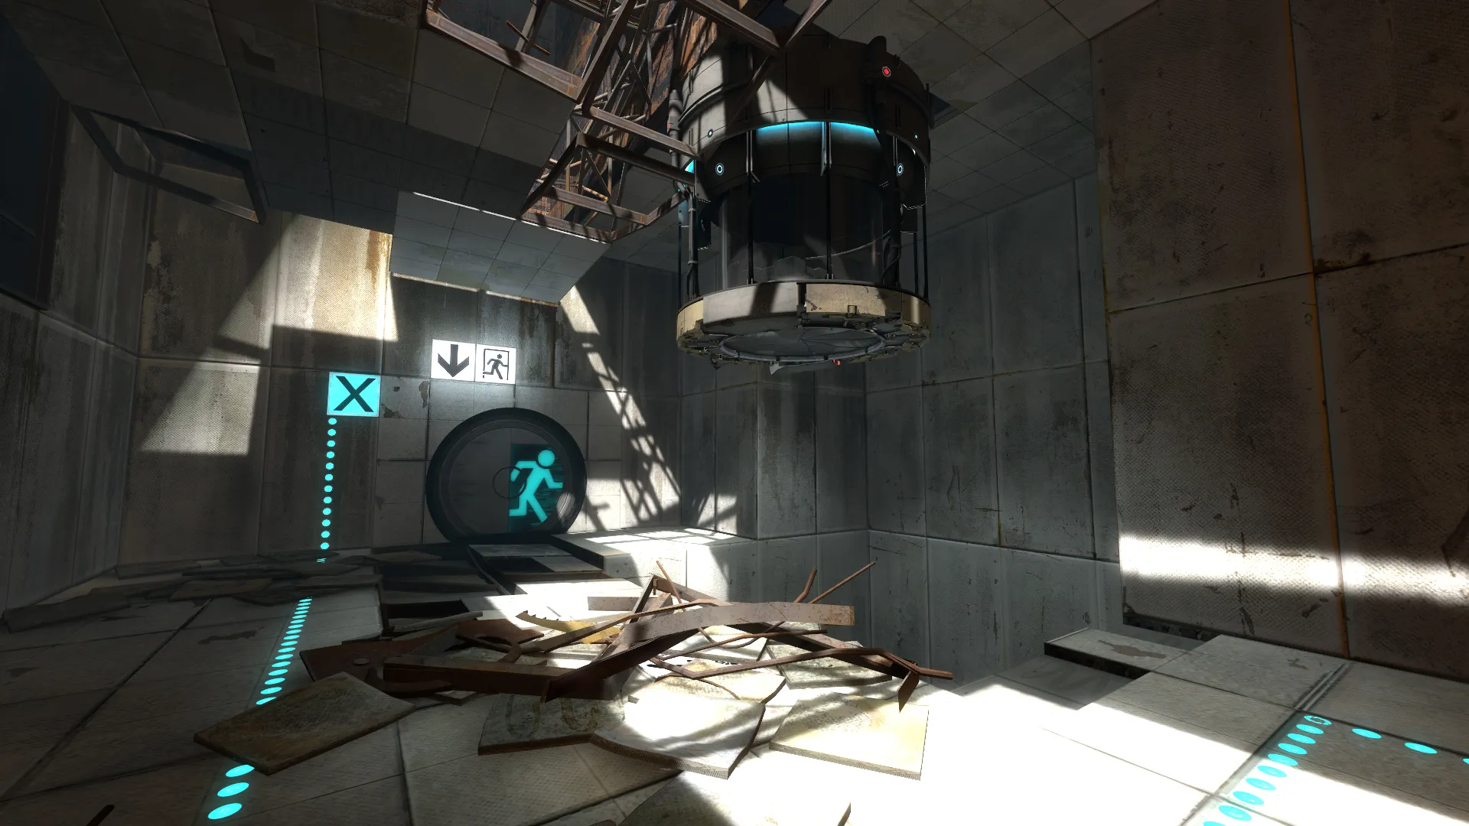
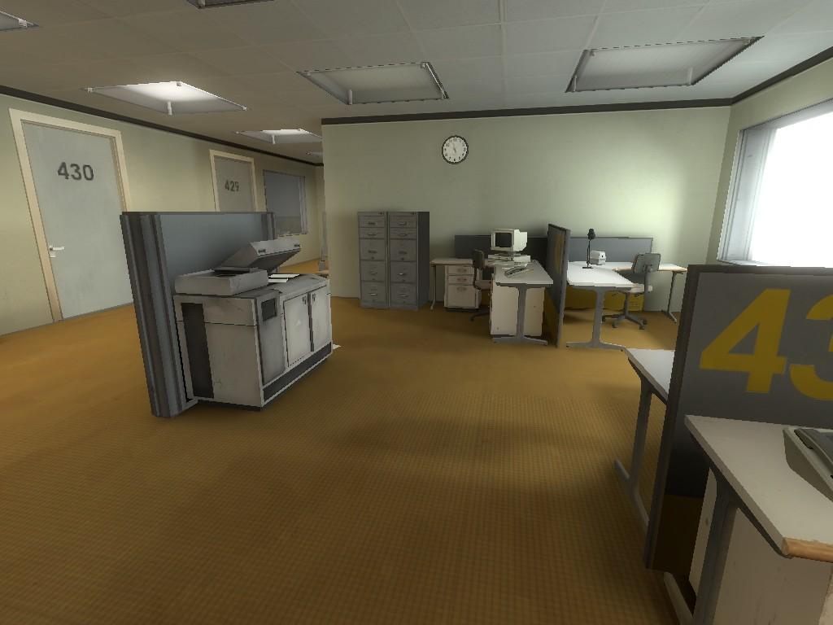
Inspirations

Slide 6
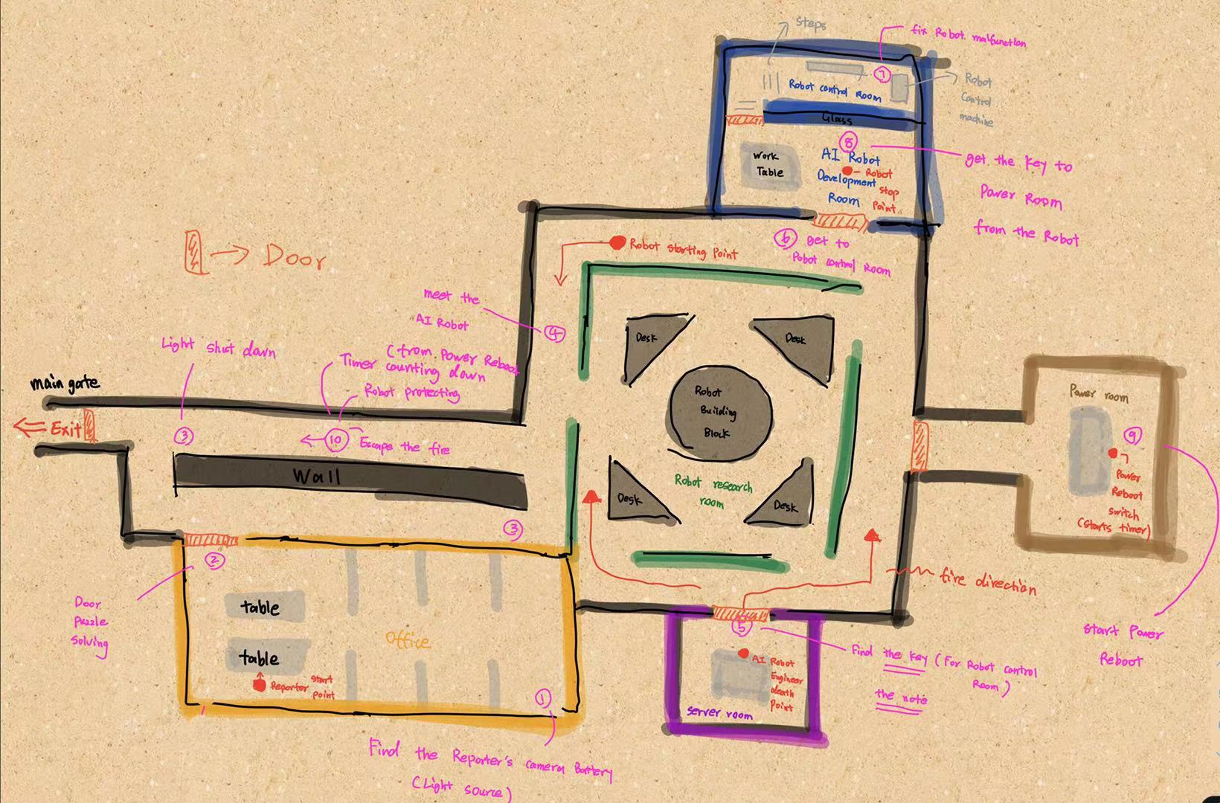
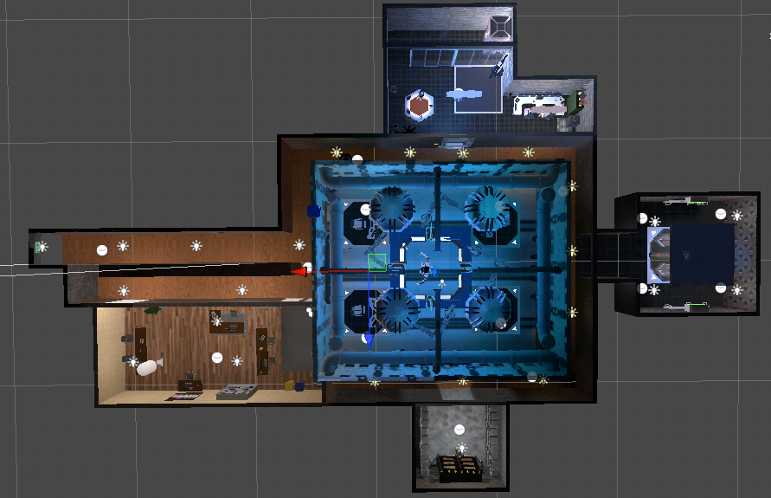
Map Layout
Map Layout
Map Layout Sketch
Notes:
explain what which room is

Slide 7
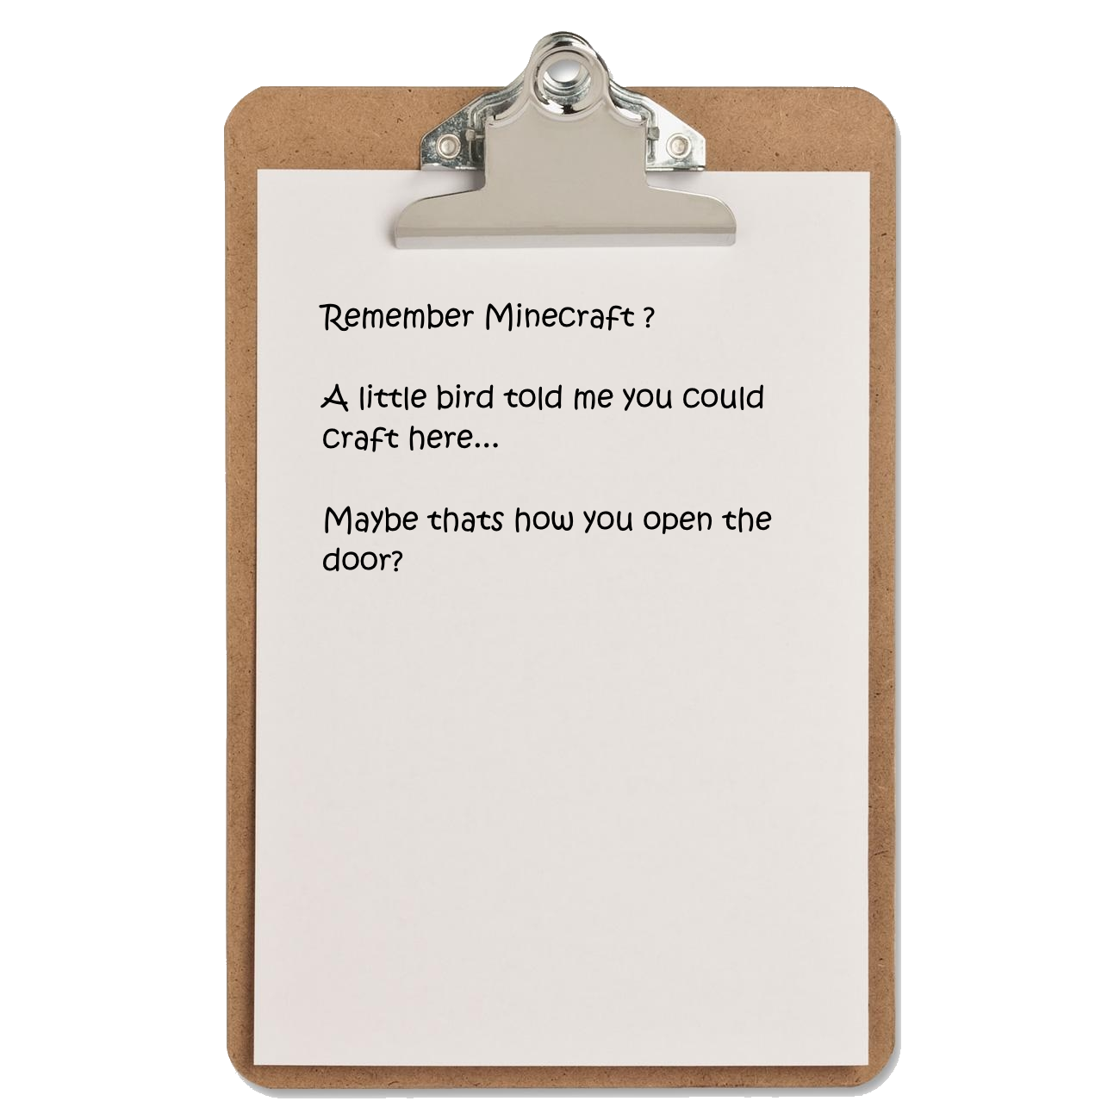
Guiding the Player
Characters
Reporter (main character, player controller)
Newly developed AI Robot Prototype (enemy, chaser, & friend, protector)
Dead Engineer (gives backstory to the space)
The player will be given a backstory, and instructions through the use of notes in game

Slide 8
Puzzles and Obstacles
Unlock office door.
Head to head with the robot
Finding the engineer corpse.
Get the overwrite circuit. & read the note from the engineer.
Overwrite the robot when it is in its control machine.
Follow the robot to the power room
Turn the power back on.
A fire starts
Escape from the fire to main gate.
Robot protects the reporter.
The reporter escapes through the main gate.

Slide 9
Gameplay Mechanics
Search & find – rooms, crafting materials, etc
Puzzle solving, use of the right combination to unlock door, note reading, etc
Robot chasing, fire spreading, player escape.

Slide 10
Ingame images
And now…

Slide 11
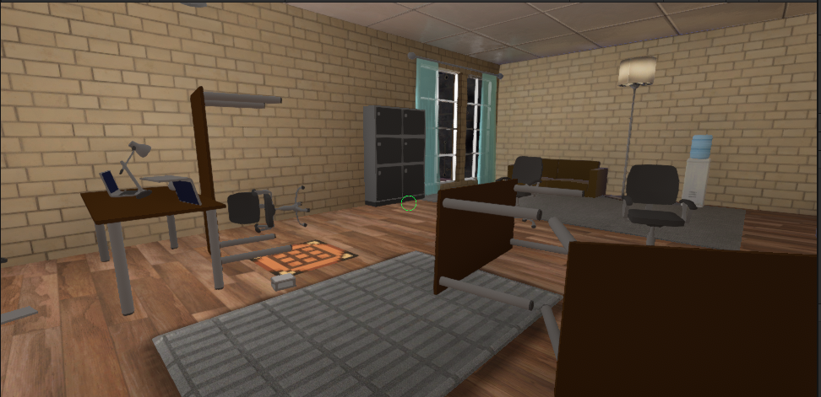

Slide 12
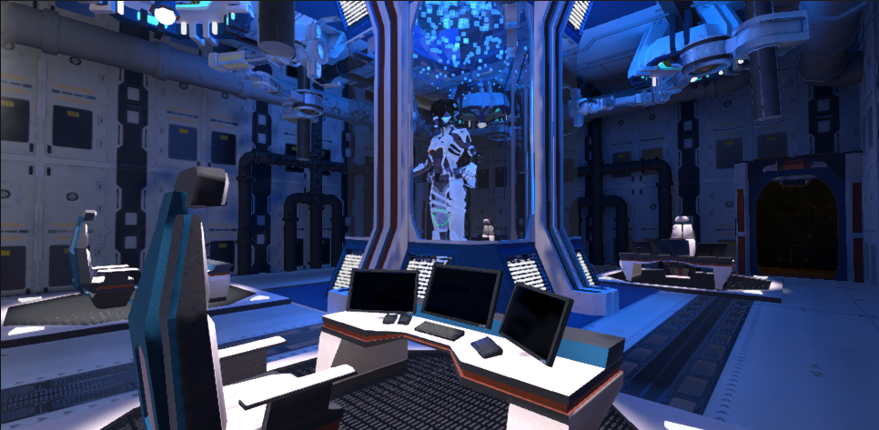

Slide 13
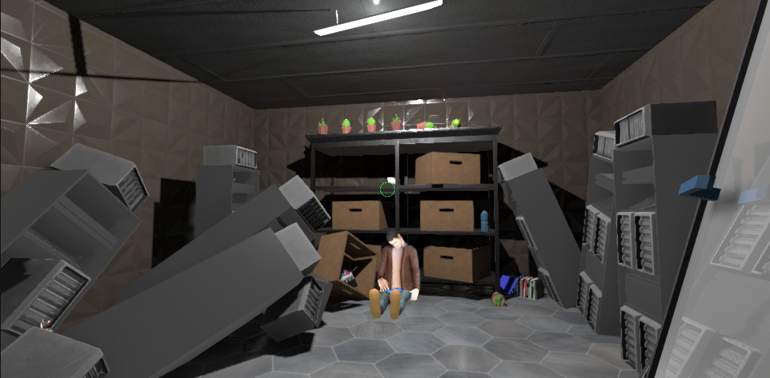

Slide 14
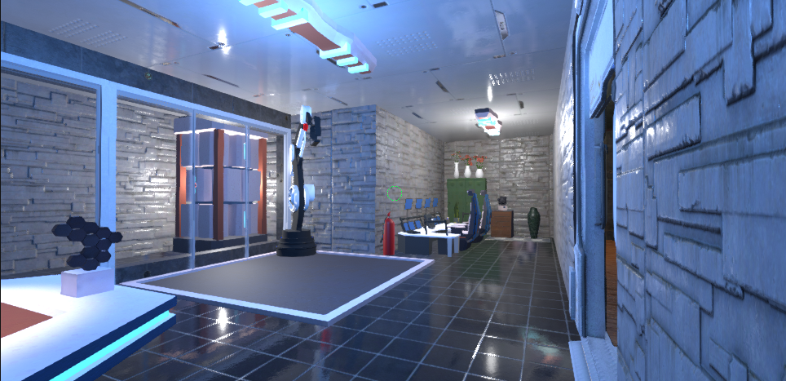

Slide 15
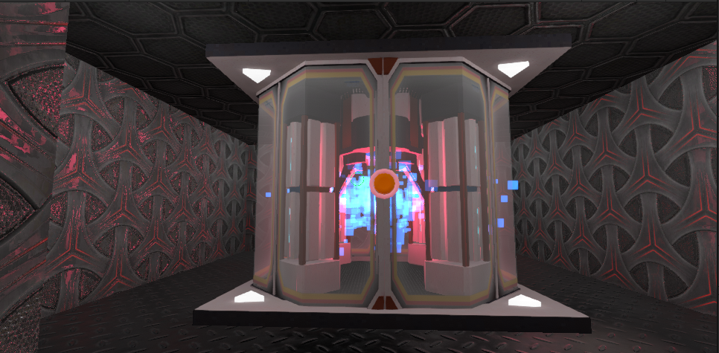

Slide 16
Implemented so far
Room designs
Robot AI: idle, patrol and chase states
3D environment model and textures
Light setup
Office door Puzzle
Pickup and Crafting mechanics

Slide 17
Remaining Features to Implement
Robot 3d model
Robot AI: repair, friendly states
Robot Animations
Fire Spreading
Engineer death note

Slide 18

In game footage

Slide 19
Thanks for watching!

